Slide 1
Power Bi assignment 6 IRTAZA

Slide 2
AGENDA
Identify most popular routes.
Determine peak travel time.
Analyze revenue from different tickets types and classes.
Diagnose on time performance

Slide 3
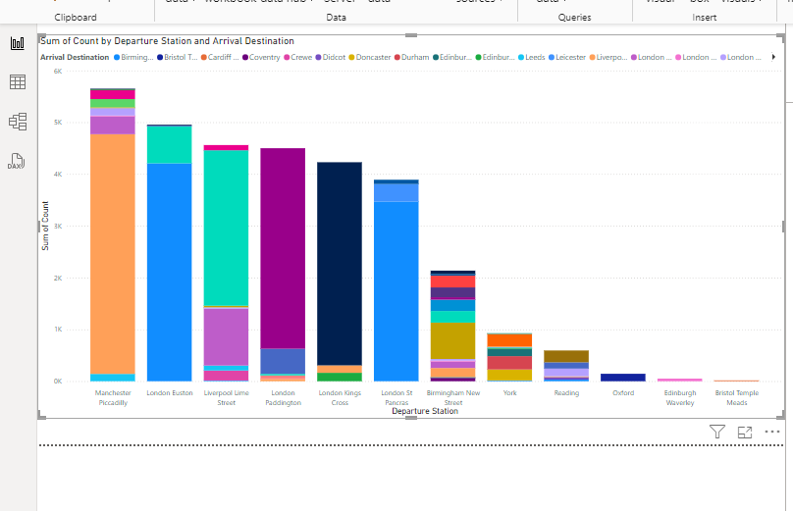
Identify most popular routes
Create group by select advance and then select departure station and arrival destination against aggregation of the transaction id it give you count of every journey

Slide 4
Explanation
The stakeholder want to determine the most popular routes of train between two cities so they can increase the number of trains between them. From data set of one year we study the every ticket route and separated them on the basis of every route and count every route total passengers, we do It using the tool power bi

Slide 5
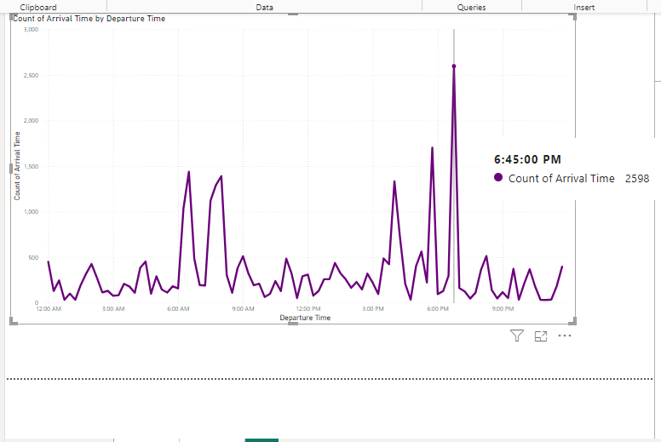
Determine peak travel time
line chart against count of departure time in x axis and arrival time in y axis

Slide 6
Explanation
The stakeholder want to determine the peak travel time so they can increase their service during that time so we listed the every ticket again and read the arrival and departure time of that passengers train so we can determine the peak travel time against departure and arrival which is 6:45 PM probably the time of leave from offices.

Slide 7
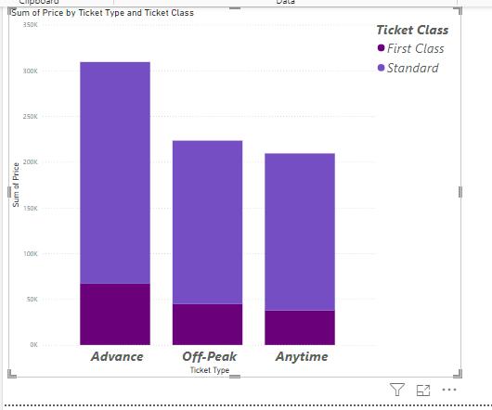
Analyze revenue from different ticket types & classes
calculate sum of ticket prices against ticket type and class

Slide 8
Explanation
The stakeholder want to calculate the total revenue of from trains on the basis of ticket types (advance, off-peak, anytime) and ticket class (first and standard so we sum the price of every ticket against ticket types and ticket class column.

Slide 9
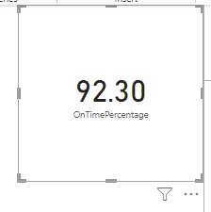
Diagnose on time performance
Make measure of on time and delayed journey separately and then make different measure of ontime percentage

Slide 10
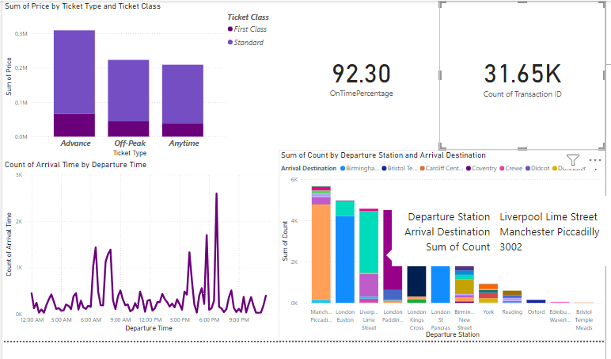
Final Dashboard

Slide 11
Thank you
IRTAZA
irtazasheikh402@gmail.com

